Slide 1
Mutual Fund Ratings

Slide 2
Mutual fund ratings
Investment Return
Time value of money
Investment return calculation
Passive fund vs. Positive fund
Return comparison: can you beat the market?
Mutual fund ratings

Slide 3
What dose time value of money mean?
This is one of the most basic financial principle
The idea that money available at the present time is worth more than the same amount in the future due to its potential earning capacity. This core principle of finance holds that, provided money can earn interest, any amount of money is worth more the sooner it is received.

Slide 4
Draw a time line
A time line is simply a diagram of the cash flows associated with a TVM problem.
PV₀
FV₅
I = 3.5%
0 1 2 3 4 5
$1,500
- $800
$2,500
$300
Cash Flow

Slide 5
The Time Value of Money(货币的时间价值)
终值：Future Value (FV): The value of an asset or cash at a specified date in the future.
现值：Present Value (PV) ：The current worth of a future sum of money or stream of cash flows given a specified rate of return
现金流：Cash Flow: A series of cash inflow and outflow associated with timeline.
A cash flow that occurs in the present (today) is put at time 0.
Cash outflows (payments) are given a negative sign.
Cash inflows (receipts) are given a positive sign.
Discounting calculate the PV to the beginning of the investment period.
Compounding calculate the FV to the end of period.
Notes:
货币的时间价值：
http://www.investopedia.com/video/play/understanding-time-value-of-money

Slide 6
The Time Value of Money
Stated annual interest rates, or nominal rates – Financial institution usually quote rates
Periodic rates – the rate of interest earned over a single compounding period
Effective annual rate (EAR) – annual rate of return actually being earned after adjustments have been made for different compounding periods.
EAR = ( 1 + periodic rate) ^{m} – 1=(1+1%)^12-1
Where:
Periodic rate(期间利率) = nominal rate/m
M= the number of compounding periods per year
Notes:
复利终值：F = P(1+i)^{n}
复利符号：(F/P，i，n)
单利：F=P+ n* I
复利次数：M
期间利率：
Effective annual rate (EAR)：有效年利率

Slide 7
Computing EAR
If the nominal rate is 12%, compounded quarterly, compute EAR
Answer:
Here m = 4, so the periodic rate is 12/4 = 3%
Thus, EAR = ( 1 + 0.03) ⁴ – 1 = 1.1255 – 1 = 0.1255 = 12.55%
Computing EARs for a range of compounding frequencies
Using a stated rate of 6%, compute EARs for semiannual, quarterly, monthly, and daily compounding.
Answer:
Semiannual compounding = (1 + 0.03)² – 1 = 6.09%
Quarterly compounding = (1 + 0.015)⁴ – 1 = 6.136%
Monthly compounding = (1 + 0.005)¹² – 1 = 6.168%
Daily compounding = (1 + 0.00016438)³⁶⁵ – 1 = 6.183%

Slide 8
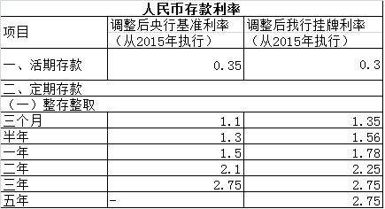
人民币存款利率表
Notes:
from中国邮储银行

Slide 9
各项贷款利息
二、各项贷款
金融机构贷款利率
短期贷款
一年以内（含一年） | 4.35
中长期贷款
一至五年（含五年） | 4.75
三、个人住房公积金贷款
五年以下（含五年） | 3.50
五年以上 | 4.00

Slide 10
Future Value and Present Value
FV = PV( 1 + i ) ^{n}
PV = FV / ( 1 + i )^{n}
Present Value of a Perpetuity
PV = PMT/ i
Notes:
i=interest rate
FV=Future Value(终值)
PV=Present Value(现值)
PMT = Perpetual Annuity(永续年金)
Notes:
复利终值：F = P(1+i)^{n}
复利符号：(F/P，i，n)
单利：F=P+ n* I
复利系数表:
http://www.lstvu.net.cn/kj/cwgl/xsbcx/02.htm

Slide 11
The Rule of 72: double your Money!!
Quick! How long does it take to double $5,000 at a compound rate of 12% per year (approx.)?
We will use the “Rule-of-72”.

Slide 12
The Rule of 72: double your Money!!
Quick! How long does it take to double $5,000 at a compound rate of 12% per year (approx.)?
Approx. Years to Double = 72 / i%
72 / 12% = 6 Years
[Actual Time is 6.12 Years]

Slide 13
Investment return calculation
Money weighted return
Time weighted return

Slide 14
Money-weighted return and Time-weighted return
The money-weighted return is defined as the internal rate of return on a portfolio, taking into account all cash inflows and outflows.
The time-weighted return measures compound growth复合增长率.
Example of the money-weighted return
Assume an investor buys a share of stock for $100 at t = 0 and at the end of the first year (t=1),she buys an additional share for $120. At the end of year 2, the investor sells both shares for $130 each. At the end of each year in the holding period, the stock paid a $2.00 per share dividend. What are the money-weighted return and time-weighted return
 | T=0 | T=1 | T=2
Purchase | 1 stock @ $100 | 1 stock @ $ 120
Sale |  |  | 2 stocks @ $ 130= $260
Dividend |  | 2 $ | 2*2 = 4 $

Slide 15
Money-weighted return and Time-weighted return
Money-weighted return（资本加权收益率）
Step 1: Determine the timing of each flow and inflow(+) and outflow(-)
t = 0: purchase of first share = -$100.00
t = 1: dividend from first share = +$2.00
purchase of second share = -$120.00
Subtotal, t = 1 -$118.00
t = 2: dividend from two shares = +$4.00
proceeds from selling shares = +$260.00
Subtotal, t = 2 +$264.00
Step 2: PVoutflows = PVinflows
$100 + $118/(1+r) = $264/(1+r)²
Step 3: Solve for r(MWR) is 13.86%

Slide 16
Money-weighted return and Time-weighted return
Time-weighted return (时间加权收益率)
Step 1: Break the evaluation period into two subperiods:
Holding period 1: Beginning price = $100.00
Dividends paid = $2.00
Ending price = $120.00
Holding period 2: Beginning price = $240 (2 shares)
Dividends paid = $4.00 ($2 per share)
Ending price = $260.00 (2 shares)
Step 2: Calculate the HPR (holding period rate) for each holding period
HPR1 = [($120 + 2)/ $100] – 1 = 22%
HPR2 = [($260 + 4)/ $240] - 1 = 10%
Step 3: Find the compound annual rate over the 2-year period.
(1 + time-weighted return) ² = (1+22%)*(1+10%)
Time-weighted return = 15.84%

Slide 17
Money-weighted return and Time-weighted return
In the investment management industry, the time-weighted rate of return is the preferred method of performance measurement, because it is not affected by the timing of cash inflows and outflows.
But, however, if the fund manager has discretion over the timing of cash flow, performance should be evaluated based on Money weighted rate of return.

Slide 18
Mutual fund investment return
Mutual fund return is the Time weighted rate of return.
From the long run, it is hardly for mutual fund or any investment vehicle to beat the market.
Passive investment & Positive investment
Foreign: Breaking news: Mutual fund managers keep failing to beat the market
Standard & Poor's released its latest Indices Versus Active Funds Scorecard today, and the headline result is the same one delivered by almost every study of mutual fund performance since the 1960s: Most actively managed mutual funds underperform the market. To be precise, 66.21% of actively managed domestic stock funds underperformed the S&P Composite 1500 Index in the five years from 2004 through 2008. During the previous five-year period, a smaller majority—50.76%—had underperformed.

Slide 19
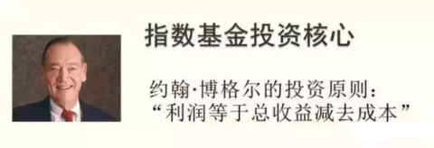

Conclusion: It’s nearly impossible to beat the market constantly
Choose passively managed fund (Index fund)

Slide 20
Mutual fund ratings
Mutual fund ratings are issued by third party institutions to help investors to evaluate the history performance of a fund
Most famous rating methods:
MorningStar (晨星)
Lipper (路透旗下：理柏)

Slide 21
Moring Star Rating System (Two features)
The Morningstar system relies on a single metric: a calculation of risk-adjusted return.
Also adjusted with investor utility functions, taxes
Mutual funds are evaluated against a peer group
Classification is the base of ratings:
Equity, bond, balance, money market, principle preservation
Notes:
Metric: 衡量标准

Slide 22
Rating steps
1. Classify funds, in each category
2. Calculate risk adjusted return
3. Rank them, top 10%, 5 Stars; bottom 10%, 1 Star
4. Only for past performance, reference for future
Funds are rated for up to three time periods-three-, five-, and 10-years and these ratings are combined to produce an overall rating. Funds with less than three years of history are not rated.

Slide 23
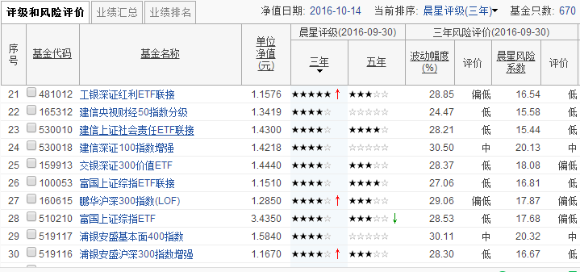
Sample
晨星基金评级

Slide 24
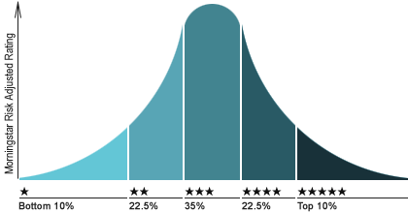
Sample
Notes:
晨星把每只具备3年以上业绩数据的基金归类，在同类基金中，基金按照“晨星风险调整后收益”指标（Morningstar Risk-Adjusted Return）由大到小进行排序：前10%被评为5星；接下来22.5%被评为4星；中间35%被评为3星；随后22.5%被评为2星；最后10%被评为1星。在具体确定每个星级的基金数量时，我们采用四舍五入的方法。

Slide 25
Lipper Rating System
Lipper ranks mutual funds according to a peer-based performance system which measures returns according to specific time frames and fund classifications (small, mid, multi and large-cap).
Multi metrics based rating methods
Scores are subject to change every month and are calculated for the following periods: 3-year, 5-year, 10-year, and overall.

Slide 26
Five Metrics
1. Total Return Criterion
Lipper ratings for Total Return reflect funds' historical total return performance relative to peers. A Lipper Leader for Total Return is a fund that has provided superior total returns when compared to a group of similar funds.
2. Consistent Return Criterion
Lipper ratings for Consistent Return reflect funds' historic returns, adjusted for volatility, relative to peers. A Lipper Leader for Consistent Return is a fund that has provided superior consistency and risk-adjusted returns when compared to a group of similar funds.
3. Preservation Criterion
Lipper ratings for Preservation reflect funds' historical loss avoidance relative to other funds within the same asset class. A Lipper Leader for Preservation is a fund that has demonstrated a superior ability to preserve capital in a variety of markets when compared with its peers.
4. Expense
Lipper ratings for Expense reflect funds' expense minimization relative to peers with similar load structures. Lipper Leaders for Expense are funds that have successfully managed to keep its expenses low relative to its peers and within its load structure.
5. Tax Efficiency
Lipper ratings for Tax Efficiency reflect funds' historical success in postponing taxable distributions relative to peers. A Lipper Leader for Tax Efficiency is a fund that has been successful at postponing taxes over the measurement period relative to similar funds.
Notes:
评级分类
1.总回报评级
2.稳定回报评级
3.保本能力评级
4.费用评级
5.避税能力评级(仅限于美国)

Slide 27
Lipper China
「理柏基金评级系统」每月更新，并按一年、两年、三年和综合的表现计算评级。所有属于股票型、债券型或混合资产型的开放式基金（货币基金和保本基金除外），具有至少一年的价格数据，并且同类型基金中至少有5只满足评级条件，就符合评级资格。 同类型基金中，领先的20%基金为第5级，被授予“优”(Leader)称号，之后均以20%为标准再区分为第4级、第3级、第2级及第1级。目前在内地所推出的评估标准有四种，包括费用、总回报、稳定回报和保本能力∶ ·在总回报上获第5级，即被授予“优”(Leader)的基金，反映在其所属基金分类中有较高的总收益。 ·在稳定回报上获第5级，即被授予“优”(Leader)的基金，反映在其所属基金分类中有较好的稳定性和风险调整收益。 ·在保本能力上获第5级，即被授予“优”(Leader)的基金，反映在其所属资产类别（股票、混合资产、或债券）中有较高的保本能力。 ·在费用上获第5级，即被授予“优”(Leader)的基金，反映在其所属基金分类中有较低的总体费用率。 ※「理柏基金评级」是基于相对性的考虑而非绝对性，而且并没有构成任何买入或卖出基金的建议。投资者应谨记过去表现并不保证未来回报。部分基金分类和资产类别本身潜在的风险较大，甚至在这些风险较大的基金分类或资产类别中获“优”（Leader）的基金也未必适合风险承受能力较少及投资目标较短期的投资者。

Slide 28
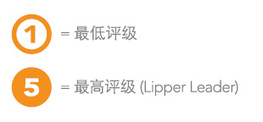
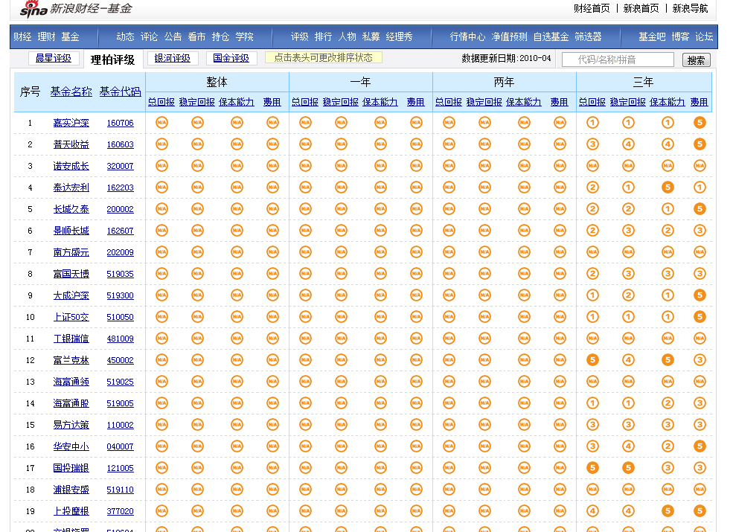

Slide 29
Weekly Quiz
1. What is the difference between time weighted return and money weighted return? Which is suitable for what scenarios?
2. If you have RMB 10,000 money deposit in bank, the interest rate is 7% and is compounded annually, how long will it to double this account?

